Slide 1
Supplier Guidance on how to apply entry onto the Pseudo DPS

Slide 2
All bidders wanting to join the Pseudo DPS will be required to register on the YORtender (Mercell) portal, by following the instructions in this Presentation.
If the bidder is already registered on the YORtender (Mercell) Portal please skip to slide 5.

Slide 3
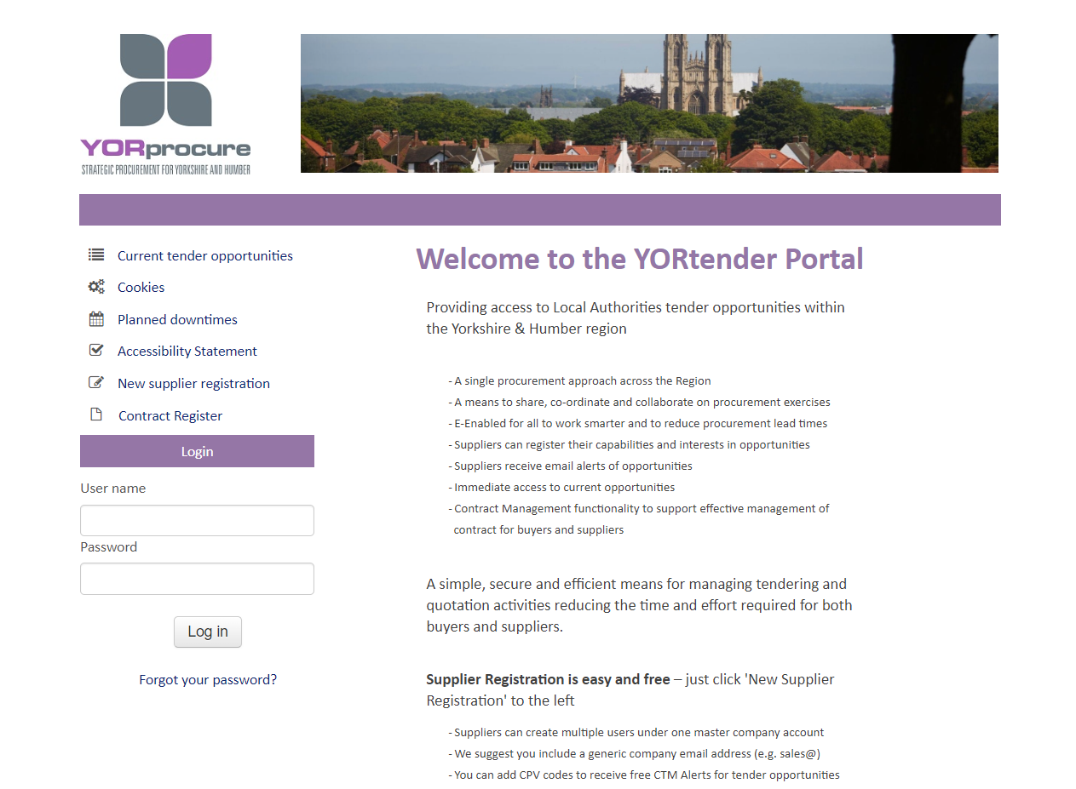
Step 1. Register onto YORtender (Mercell)
If the bidder is not registered on the YORtender (Mercell) portal, they can register via the following link - https://yortender.eu-supply.com/login.asp?B=YORTENDER.
To register click on the “New supplier registration” button on the webpage.

Slide 4
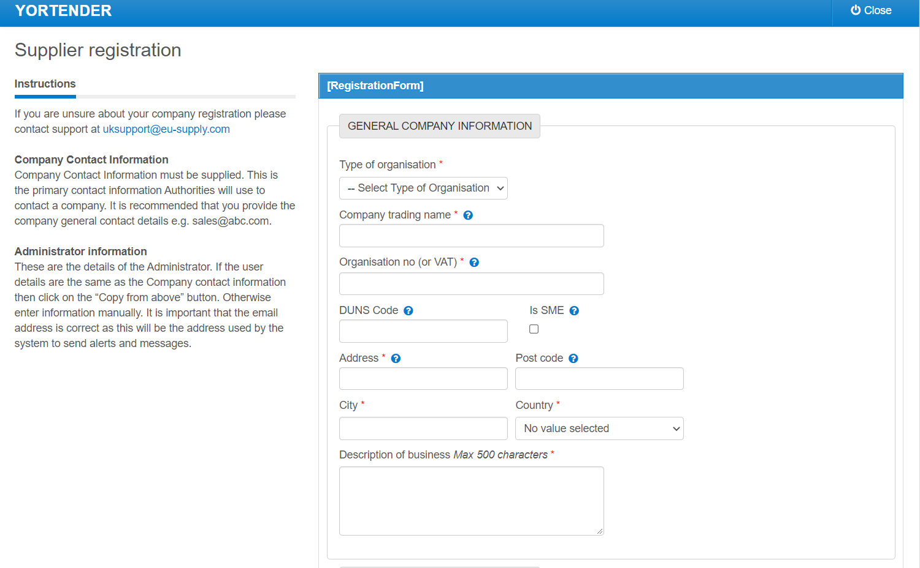
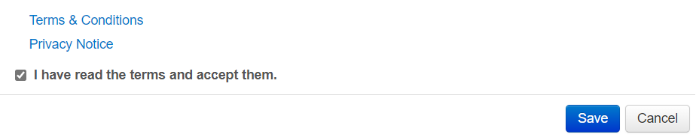
Step 2. Registration Form
Complete the registration form with your organisations details to set up an account with YORtender.
Step 3. Accept Terms
Once done, accept the terms at the bottom of the page and click “Save”.

Slide 5
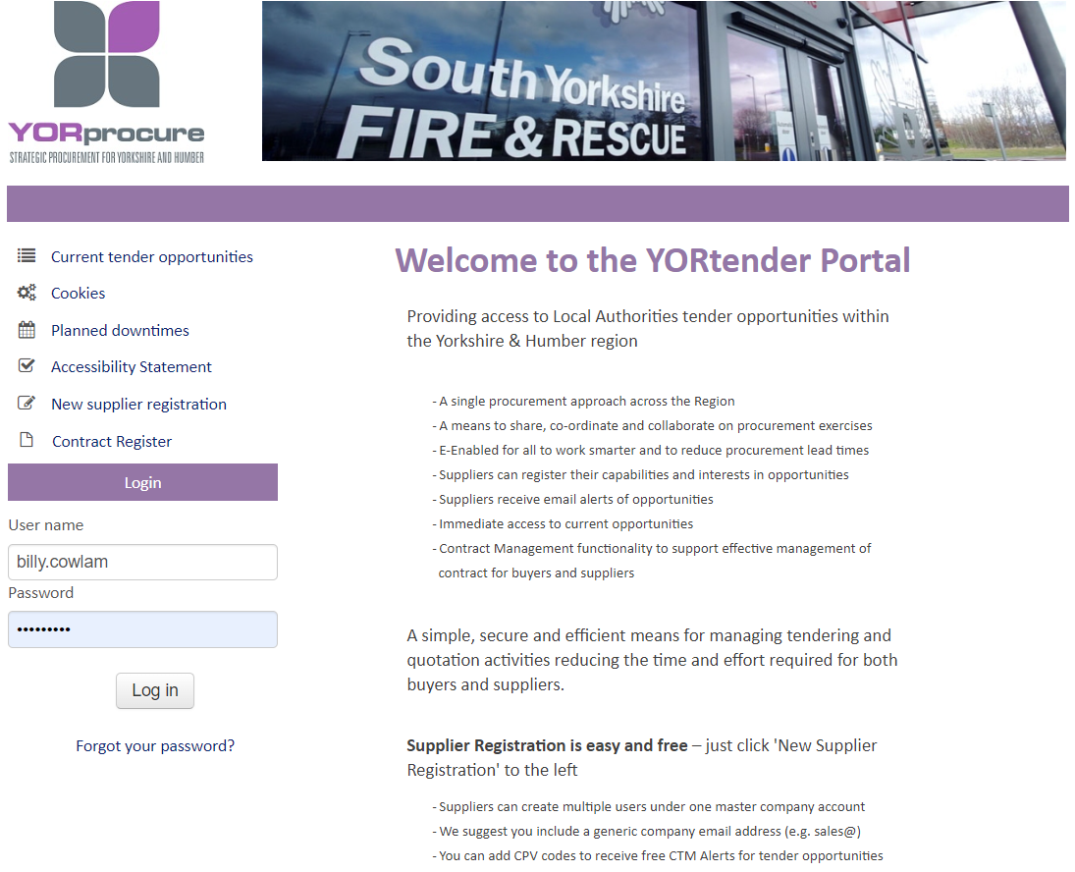
Step 4. Log into YORtender (Mercell)
To log onto the YORtender website you will need to input your User name and Password. Once done, press the Log in button to gain access to the website.
https://yortender.eu-supply.com/login.asp?B=YORTENDER

Slide 6
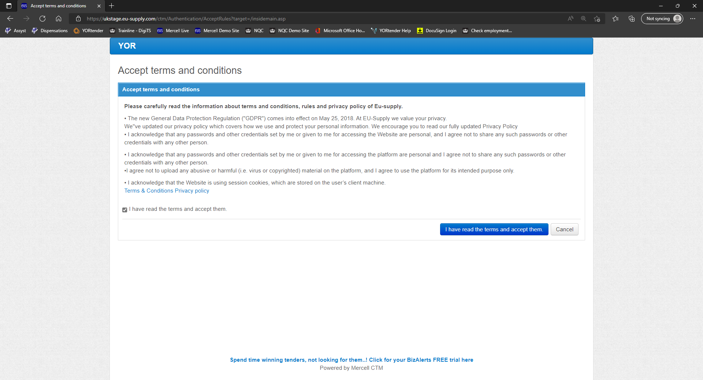
Step 5. Accept terms and conditions
First time users will need to accept YORtender terms and conditions. These terms are to use the Mercell website and are required to access the DPS.

Slide 7
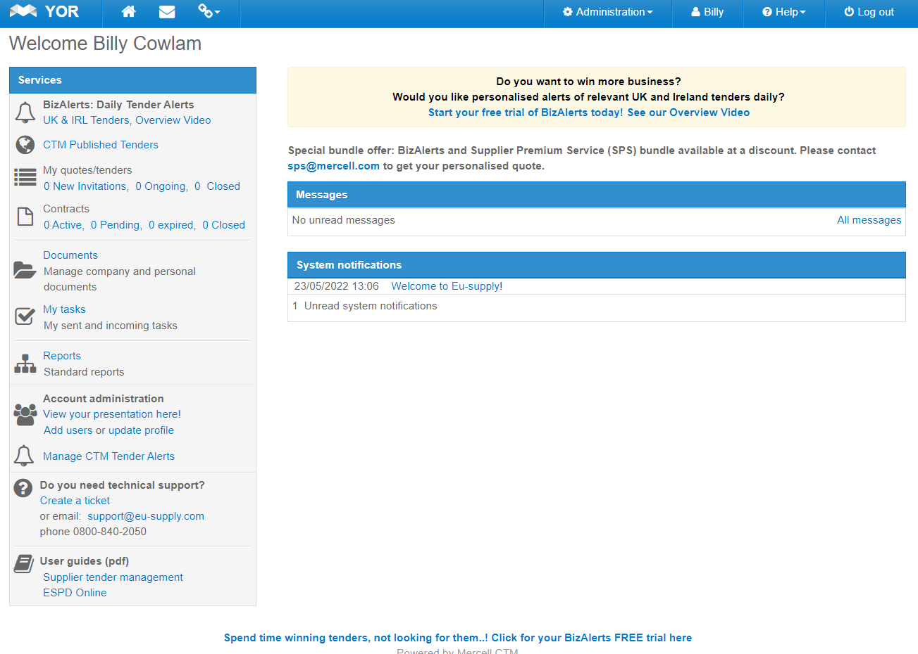
Step 6. Access all current published tenders
Within the Home page, see the Services section and Click on CTM Published Tenders.
If the bidder requires amending their organisational details, you can access this through the “Administration” area at the top of the page.

Slide 8
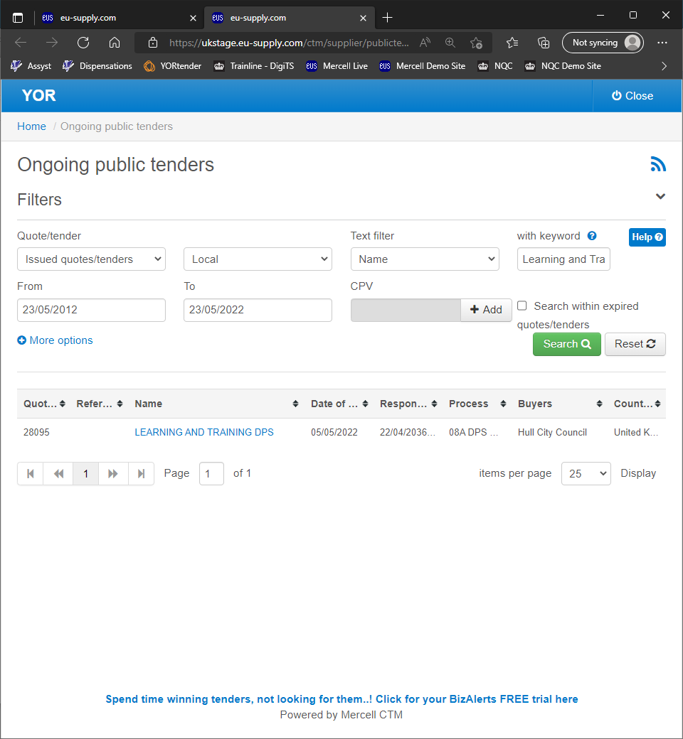
Step 7. Finding the DPS
1
Within the “with keyword” box, type “(ROSE)”.
Press the green “Search” button.
(ROSE), will appear in blue below the title Name.
Click on “(ROSE)” below the Name highlighted in blue to access the DPS.
*Note in relation to the screen shot on the right, the text circled in Red, are just examples, by following Steps 1-4 above will help you locate the DPS.
2
3

Slide 9
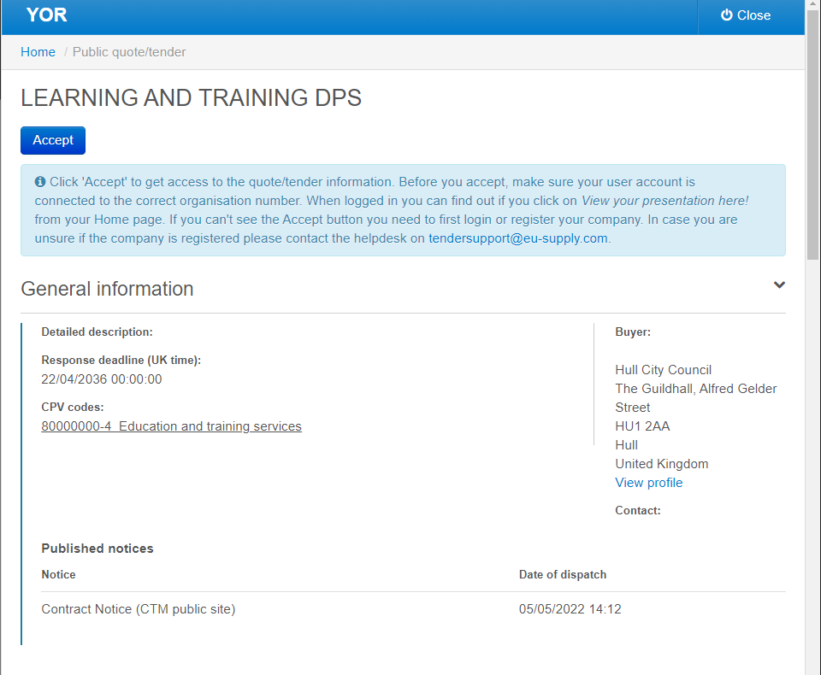
Step 8. DPS Acceptance Page
First time bidders will be met with this acceptance page. To access the Pseudo DPS the bidder must click on the blue “Accept” button.
Please note that you cannot see the documents on this page.

Slide 10
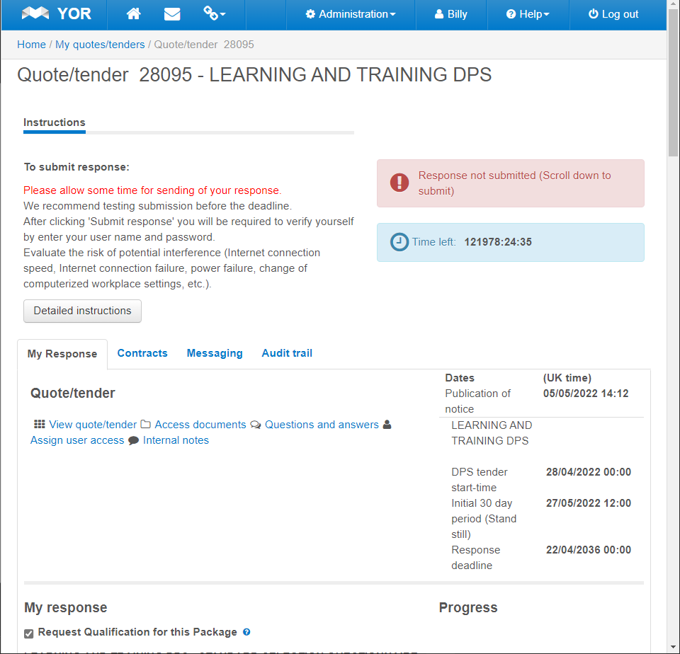
Step 9. DPS Home Page / Bid Pack
When the bidder first accesses the DPS Homepage it is highly recommended to access the Bid Pack before answering the questions.
To view the Bid Pack, the bidder must click on the “Access documents” link under “Quote/Tender”. This will pop out a new window with the documents listed.
*Note For a General overview on the DPS homepage, please go to slide 17.

Slide 11
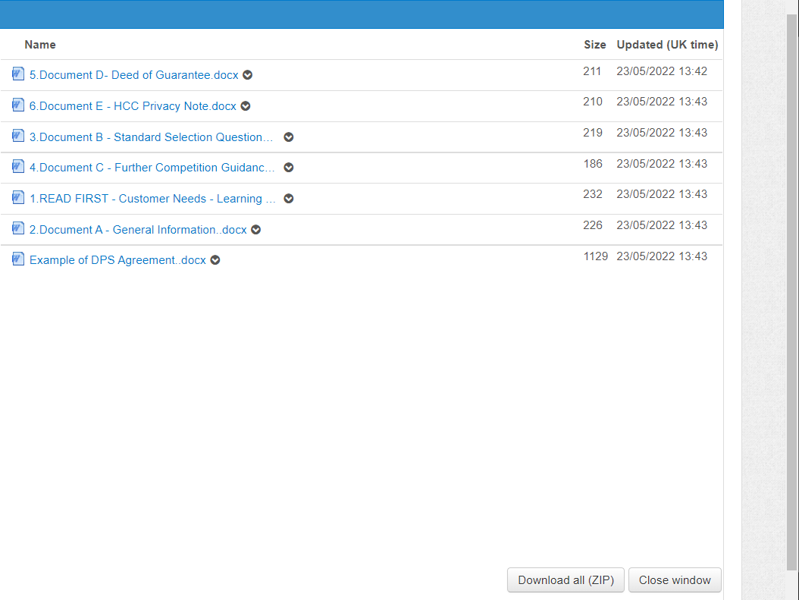
Step 10. Downloading documents
To download the documents you can either:
Click on the “Download all (ZIP)” button at the bottom of the window to bulk download all documents.
Download each one-by-one by clicking on the document.

Slide 12
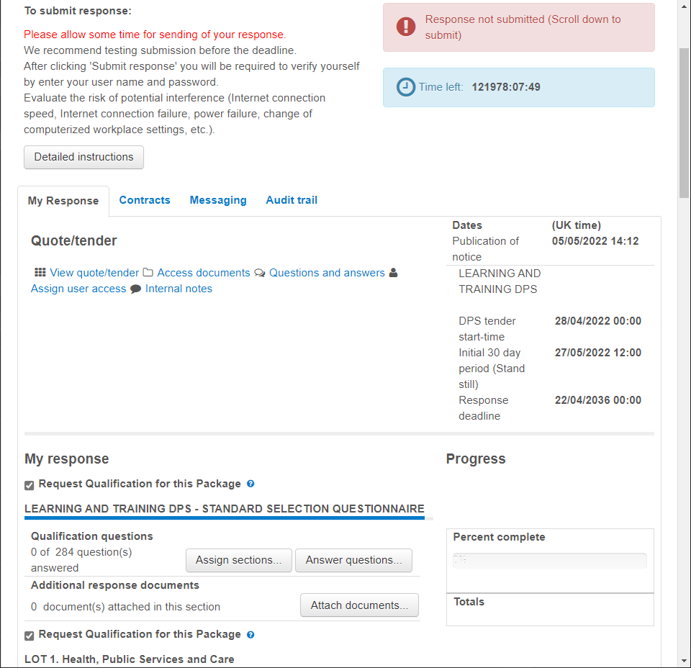
Step 11. Accessing the Standard Selection Questionnaire
It is advised to read the Bid Pack documents before answering the SSQ.
To begin answering the questions on the SSQ you will need to click on the “Answer Questions” button as shown.

Slide 13
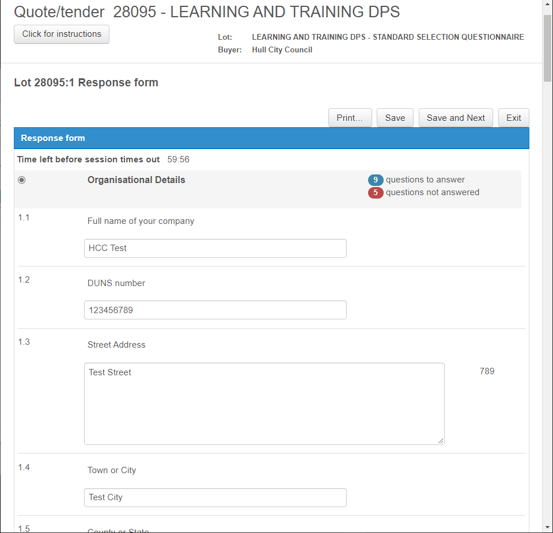
Step 12. Answering the Standard Selection Questionnaire
3
Section name of SSQ
Total questions to answer in blue and remaining questions to answer in red
Press “Save and Next” to move onto a new section
Question boxes to put your answers into
Question number
If the bidder wishes to take a break during completing the SSQ, it is recommended to press the “Save” button and then “Exit” to ensure your progress is saved.
1
2
4
5

Slide 14
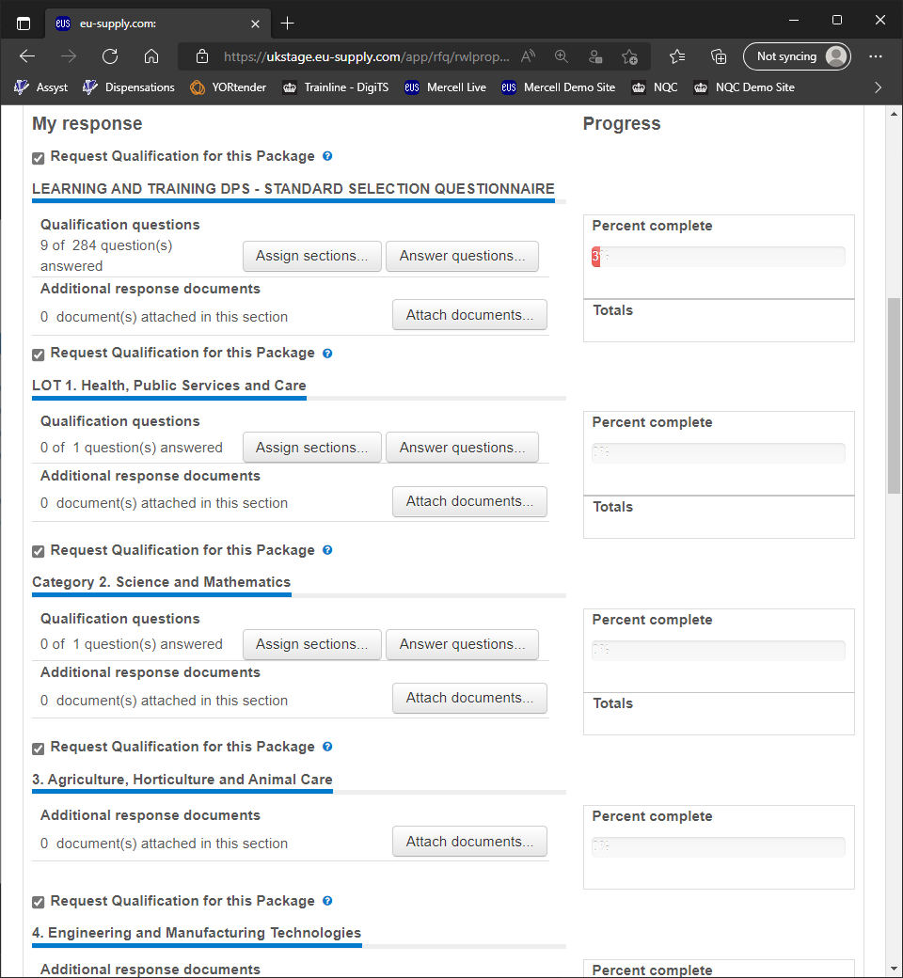
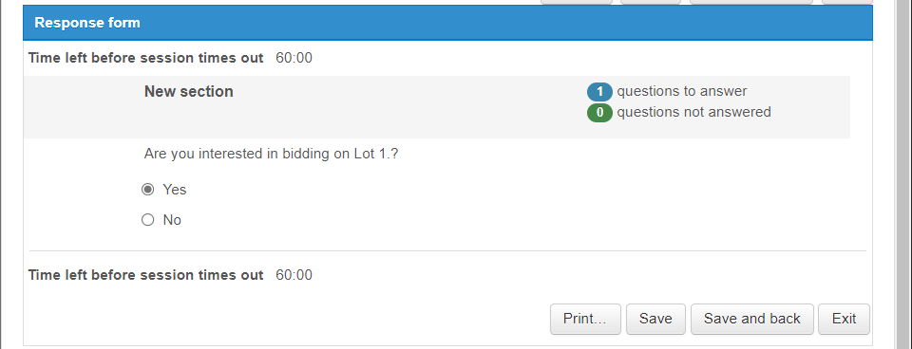
Step 13. Category Selection
Once the bidder is happy their SSQ has been completed they can begin selecting the Categories they wish to apply for.
The Categories are found below the SSQ questions.
Each Category requires the bidder to click on the “Answer Questions” button underneath them. There will be additional questions which must be answered to apply onto the specified category.

Slide 15

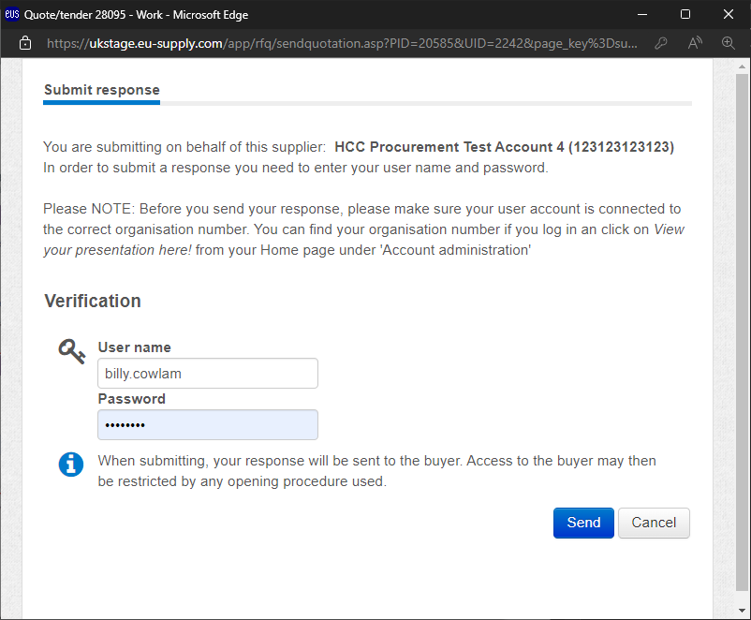
Step 14. Submitting the application
When the bidder has filled out the Standard Selection Questionnaire, the Category questions the bidder is interested in and is ready to submit the application, they can do so by scrolling down to the bottom of the page and clicking on the “Submit Response” button.
Once pressed, the bidder will need to log into their account to verify they want to submit their application.

Slide 16
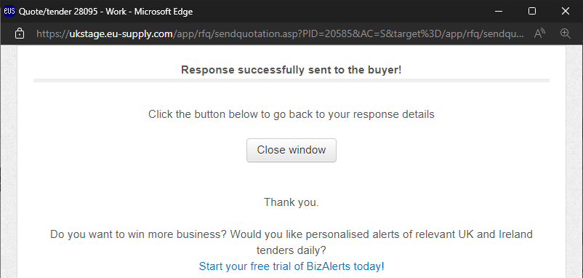
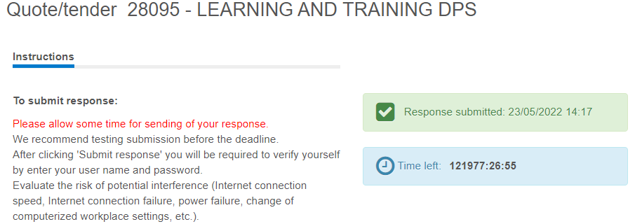
Step 15. Application sent
With the bidder pressing the “Send” button the application will then be sent to the Hull City Council to be assessed.
To double check your application has been sent, on the DPS Homepage you can find the “Response Submitted” box should have changed to a green colour.

Slide 17
DPS Homepage Overview
1
2
Notification to whether the bidders response has been submitted
Time remaining on the DPS
Access Bid Pack
All dates of importance
Standard Selection Questionnaire
Progress completed on the SSQ
3
4
6
5

