Slide 1
Hull VCSE Assembly Thursday 22nd February
@HullSector

Slide 2
Welcome
Housekeeping
Fire alarms and exits
Toilets
Refreshments
Introductions
Name
Group/organisation

Slide 3
Agenda
10.10am - Hull City Council - Community Asset Transfer
10.40am - Check-In Activity
10.55am - Matters Arising from last meeting
11.00am - Update on Digital (Helen Grimwood)
11.20am - New Models Commissioning update (Jason Stamp/Pippa Robson)
11.30am – Humber and North Yorkshire update (Jason Stamp)
11.40am - Sector Connect Updates
11.50am - VCSE Organisation updates
12.20pm - Any other business
12.30pm - Close

Slide 4
Hull City Council Community Asset Transfer Policy
2024

Slide 5
Context
The Authority’s present approach is to not agree to concessionary leases, but to instead seek full market value rental for any property that the Council owns and place full repair responsibilities upon the tenant, save where there is an economic case for doing otherwise. This is founded upon a policy adopted by Cabinet in July 2016.
The Community Asset Transfer policy addresses the absence of a clear and transparent process for the evaluation of whether an economic business case exists for a lease to be let or renewed on a concessionary basis. The adoption of the policy will address this deficit.
The development of a Community Asset Transfer policy was agreed in principle by Cabinet September 2022. The process and documents to deliver the policy are in the process of internal approvals for role out March 2024.

Slide 6
Hull CAT Model
Developed with HCC Property and Assets, Area and Neighbourhoods Team, Legal Services, Open Spaces Strategic Manager and Major Projects with Sector Connect
Model adapted from established CAT policies from Manchester, Rotherham and Dumfries and Galloway

Slide 7
Hull CAT Documents
CAT Guide
CAT Expression of Interest
CAT Consultation Guide
CAT Healthcheck Questionnaire
CAT Business Case

Slide 8
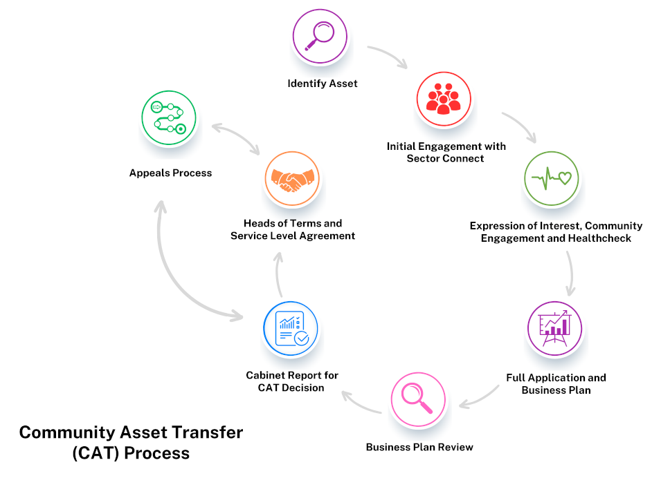
Hull CAT Process

Slide 9
Next Steps
Progress priority CAT applications
Develop a register of CAT requests and liaise with applicants on timescales for progressing
Review and amend CAT process as we gather feedback from the CAT working group and applicants

Slide 10
Question and feedback?
Debbie Akester
Head of Service
Area and Neighbourhood Team

Slide 11
Check-in activity and discussion
Premises and buildings
Sector Connect will be buying in support from the Ethical Property Foundation on managing community buildings – more details to follow
What are your premises/buildings challenges? E.g. legal, utility bills, finding somewhere suitable, sharing with others
What would you like to see in the city in terms of support for community premises?

Slide 12
Matters Arising from last meeting
Area Committee reports and minutes available on the Council website:
https://cmis.hullcc.gov.uk/cmis/CalendarofMeetings.aspx
Report available on ‘Local Centres and Neighbourhoods’ which covers the planned capital investment programme in Hull including community centres – this will be sent with the minutes

Slide 13
Update on Digital Helen Grimwood, Hull CVS

Slide 14
Strategic landscape
ICS level - Digital strategy sets out how digital & data technologies can consolidate & transform how people engage with health & care in our region over next 5-10 years
Shaped by the NHS National Strategy - 7 key priorities for Digital Transformation outlined in the What Good Looks Like’ framework
ICB recognises that Digital strategy at an ICS level must complement and support place-based digital strategies and the strategies of partner organisations
At an ICS level, the VCSE Collaborative are leading a piece of work around Digital & AI
A Hull Place IT/Digital Group now established to develop the digital strategy at place - joins up current initiatives already in play whilst also working within this national framework
Hull Place IT/Digital Group reports into the Hull Health & Care Partnership, which in turn reports to ICB level

Slide 15
What this means for the VCSE in Hull?
Feels very NHS led and far removed from day-to-day challenges facing the VCSE sector and local communities?
Are there more fundamental issues to be working through?
Do we know where we’re at and what we need as a sector/as individual organisations?
For our communities is it purely digital exclusion? Do we understand all the unique challenges?
Do we have a clear picture of what is being delivered by us to communities around digital exclusion/building digital resilience?

Slide 16
What this means for the VCSE in Hull?
Hull Place IT/Digital Group recognises the need to address some of the challenges faced by the VCSE and communities in the strategy.
However is already starting to formulate what possible solutions can be.
Are these strategies and solutions of use to your organisations and service users? Will you engage in them?
Need to make sure that the challenges facing Hull and fully heard and embedded in Hull IT Place/IT Digital group and also in the ICS VCSE collaborative work.
Low engagement in Digital related discussions and developments.

Slide 17
Quick Table Discussion
What is your organisation’s most pressing priority in terms of digital?
What is the most pressing priority in terms of digital for your services users/local community?
What would make you want to be more involved in digital discussions/working groups?
What type of topics would you like to see discussed at a digital focussed Assembly meeting?

Slide 18
New Models of Commissioning
First round-table event held Monday 5th February. Discussions focused on:
Need for consistency
Importance of market engagement
Good planning and timelines are crucial
Lack of uplifts (year-on-year increases) a challenge
TUPE can be a barrier (requirement to transfer staff)
Social Value needs more understanding
Next steps – follow-up meeting planned

Slide 19
Humber and North Yorkshire
Jason Stamp, Forum CIO

Slide 20
Humber and North Yorkshire Health and Care Partnership
Current challenges – finance and performance
Demonstrating the Value of Investment in the VCSE
VCSE Workforce Mapping
Vaccine Awareness
Volunteering for Health
Place Based Self Assessment

Slide 21
Hull Health and Care Partnership
Partnership Review and Reset
Focus on delivery of the Hull Health and Wellbeing Strategy
Three priority workstreams:
- Integrated Neighbourhood Teams
- Workforce
- Health and Care Inequalities
Recurrent Health Inequalities Funding

Slide 22
Key Activities
Partnership Review and Reset
Focus on delivery of the Hull Health and Wellbeing Strategy
Three priority workstreams:
- Integrated Neighbourhood Teams
- Workforce
- Health and Care Inequalities
Recurrent Health Inequalities Funding

Slide 23
Sector Connect Hull - Updates
High volume of requests to assist in setting up new organisations – this is positive but we are encouraging partnerships where possible as there is a significant potential for duplication
If you know of anyone wanting to start a new group or organisation please do refer them

Slide 24
Sector Connect Hull - Funding
Small grants (£15k) – Weavers’ Company Benevolent fund, smaller charitable organisations working with people at risk of crime involvement
https://northbankforum.org.uk/funding/the-weavers-company-benevolent-fund

Slide 25
Sector Connect Hull - Funding
Small grants (£5k) – Screwfix Foundation, capital, repair and maintenance for community premises (open deadline, quarterly assessment)
https://northbankforum.org.uk/funding/screwfix-foundation/
/

Slide 26
Sector Connect Hull - Funding
Small grants (£5k) – Schroder Charity Trust, education and youth, arts/culture and heritage, environment and conservation, health and wellbeing, strengthening communities (open deadline)
https://northbankforum.org.uk/funding/schroder-charity-trust/

Slide 27
Sector Connect Hull - Vacancies
Welcome House Trustee
Community Engager at Forum
Sessional Play Worker at Child Dynamix
All the latest vacancies at https://northbankforum.org.uk/vacancies/

Slide 28
Sector Connect Hull - Updates
Please do tell us about your funding successes, especially where we’ve helped!
We will be contacting organisations we’ve supported through one-to-one advice, training or networking with a feedback survey in the next few months to help us improve our services and demonstrate our impact.

Slide 29
Sector Connect Hull - Training
New Training for next quarter
Developing diverse income
GDPR
Bystander First Aid
Making Every Contact Count
Book your places HERE

Slide 30
VCSE Organisation Updates
Notes:
Matt Wright

Slide 31
Next Meeting
Next VCSE Assembly:
24th April 2024 – 1pm to 3.30pm at Centre 88, Saner Street, Hull, HU3 2TR
Book your place at https://hullcvs.org.uk/vcse-assembly-booking-form/
Next VCSE Collaborative:
19th March 2024 – 1pm to 3.30pm, venue and theme TBC (Children and Young People or Digital)
Notes:
Matt

Slide 32
Thank you
Accessing the service and contacting the team:
help@sectorconnecthull.org.uk
www.sectorconnecthull.org.uk
Twitter @HullSector
Notes:
Matt

